Slide 1
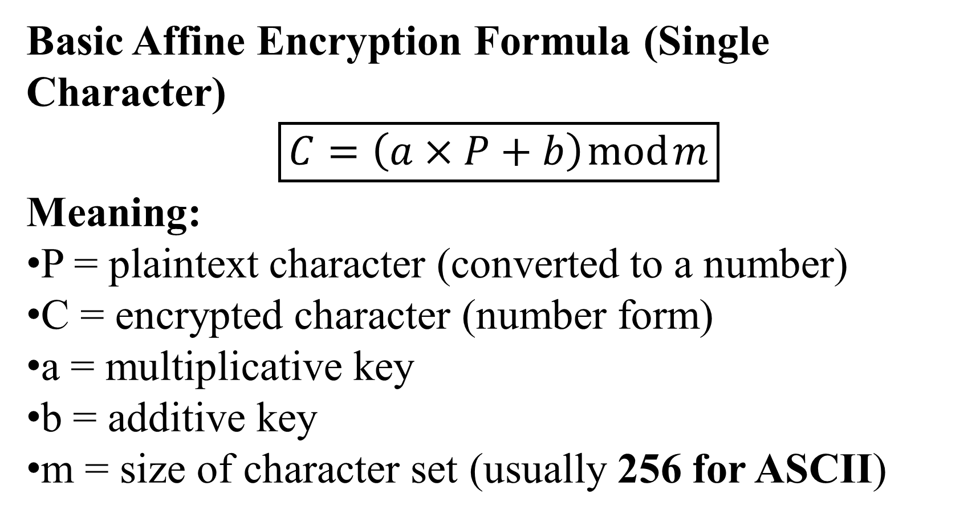
affined43d cd
Basic Affine Encryption Formula (Single Character)
$$\boxed{C=\left(a×P+b\right) mod m}$$
Meaning:
P = plaintext character (converted to a number)
C = encrypted character (number form)
a = multiplicative key
b = additive key
m = size of character set (usually 256 for ASCII)

Slide 2
ARC2 (RC2)
is a secret-key encryption algorithm. This means the same key is used to lock (encrypt) and unlock (decrypt) data.
Your message = a box
Your key = a secret lock
ARC2 = a machine that locks the box using the key

Slide 3
How ARC2 Works
Split the message
Data is broken into 64-bit blocks.
Use the secret key
The key is expanded into many small keys.
Mix the data
The data is mixed again and again using:
Addition
XOR
Bit shifting
Repeat mixing
This mixing happens many rounds to confuse the data.
Get encrypted output
The final mixed data is the cipher text.

Slide 4
How PKCS1_OAEP Works
PKCS1_OAEP adds randomness to your message before RSA encrypts it, so the same message never looks the same twice.
Step-by-Step
1 You start with a message
Example:
HELLO
2 OAEP adds randomness
OAEP creates a random number (called a seed)
This random seed is different every time
So now:
HELLO + random data

Slide 5
3 OAEP mixes everything
It uses a hash function
It scrambles the message and the random seed together
This hides patterns
Result:
Random-looking padded message
4 RSA encrypts the padded message
RSA uses the public key
Output becomes encrypted data
Encrypted data (ciphertext)

Slide 6
What is Camellia?
Camellia is a symmetric-key encryption algorithm (same secret key for encrypting and decrypting data). It is a block cipher, meaning it encrypts data in fixed-size chunks.
How it works (easy way)
Think of your data as a box.
Step 1: Put data in the box
Take 16 bytes of data at a time.
Step 2: Lock it many times
Camellia locks the box many times (rounds).
Each lock:
Mixes the data
Changes positions
Uses the secret key
Step 3: Final locked box
After many locks, the data looks random.

Slide 7
3. Unlocking the data
Use the same key
Unlock in reverse order
Original data comes back
4. Why it is safe
Many mixing steps
Strong math rules
Hard to guess without the key

Slide 8
5. Simple example
HELLO → [Camellia + key] → X9#@kP!$
Only someone with the same key can get:
X9#@kP!$ → HELLO
6. Where it is used
Secure files
Network security
Banking and enterprise systems

